Slide 1


2019
Department
Of Computer
Science
&
Electrical And
Electronics
Engineering
MATH-IV
KAS -402
2020-2021
Dr.Rupa Sharma
Associate Professor
vsrsrsys@gmail.com
Notes:
Thisv is Cover page

Slide 2
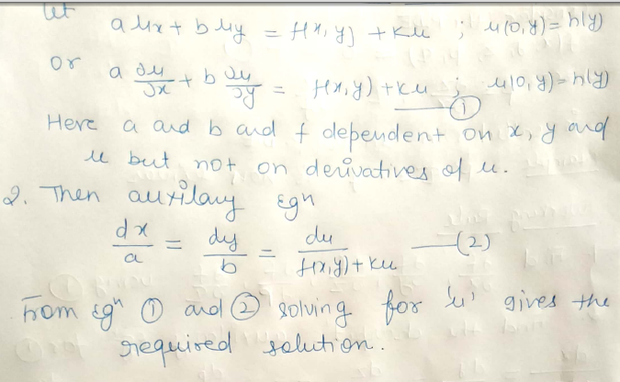
Cauchy’s Method

Slide 3
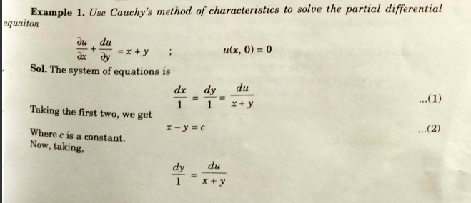
Example

Slide 4
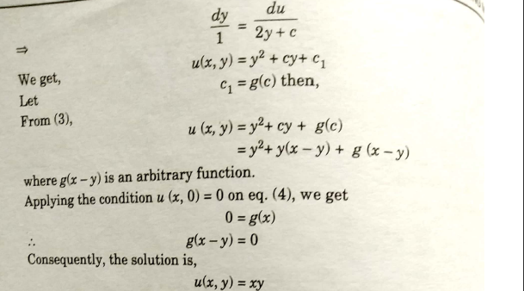

Slide 5

HOME WORk

Slide 6
THANK YOU

